Slide 1
Operating Systems and
System Level Programming
Software College of SCU
本课程为模块化课程
1-8左航、9-16熊运余
四川大学软件学院 左航(Zuo Hang)
Email: 2380588@qq.com
2019
Notes:
Now welcome to the course SLP, the final course about programming in your college life. After C and JAVA, why do we still learn how to program? This is a very good question. It’s time for us to stop and think more. The meaning and objective of this course try to make you guys more powerful and outstanding in programming. You will know not only how to program ,but have an understanding of the underlying computer system and its impact on the application programs Then you can consistently produce quality software that is faster and more reliable.
This is the only way to grow from a green hand to a master.
This course will be taught by 4 teachers. They are su, zhaok, zhaoh… and me. Each of us will teach about 4 weeks.

Slide 2
Unit 0. About this course
0.1 Introduction of this course
0.2 More details on SLP
0.3 Reference on SLP
0.4 Some suggestions
2019
Notes:
First of all, in section 1, we will talk about the content.
In section 2 and 3, we will list the rules of the class and some reference materials.
In the last part, we will share some suggestions about how to learn this course.

Slide 3
Unit 0. About this course
0.1 Introduction of this course
  0.1.1 Programmers: Lifetime of program “hello”
  0.1.2 OS: Lifetime of program “hello”
  0.1.3 SLP: Lifetime of program “hello”
  0.1.4 summary
2019
Notes:
First of all, in section 1, we will talk about the content.
In section 2 and 3, we will list the rules of the class and some reference materials.
In the last part, we will share some suggestions about how to learn this course.

Slide 4
0.1 Introduction of this course
OS+SLP
User
Application Programs (e.g. hello)
Development tools
Software
Operating System
Processor
Main memory
I/O devices
Hardware
201001V1.1
Notes:
If we run hello.exe, the shell program of the os will create a process for it and load all the code and data into the virtual memory.
Csapp page 11
As mentioned above, development tools can be used to develop application programs that meet users’ need. But All attempts by an application program to manipulate the hardware must go through the operating system. The operating system has two primary purposes: (1) To protect the hardware from misuse by runaway applications, and (2) To provide applications with simple and uniform mechanisms for manipulating complicated and different low-level hardware devices.

Slide 5
0.2 More details on this course(3/3)
Grade = 20% Lab work + 10% Attendance +20% mid-term exam + 50% final exam (close book)
Rules
  Attendance:
    Absences need not be excused.
  Late Work:
    It is generally not accepted and receives a zero.
    In the case of unplanned emergencies, speak to the instructor for a revised due date.
  Repeat Work (Retakes):
    The course will not give “incomplete”.
2019
Notes:
The final grade is composed by two parts as you can see. But the percentage may change according to the actual situation of each semester.
Absence is accepted only when emergency situation happens and you should notify the instructor.
Both the homework and lab practice should be submit on time, otherwise you may lose some points.

Slide 6
Unit 0. About this course
0.1 Introduction of this course
  0.1.1 Programmers: Lifetime of program “hello”
  0.1.2 OS: Lifetime of program “hello”
  0.1.3 SLP: Lifetime of program “hello”
  0.1.4 summary
2019
Notes:
First of all, in section 1, we will talk about the content.
In section 2 and 3, we will list the rules of the class and some reference materials.
In the last part, we will share some suggestions about how to learn this course.

Slide 7
0.1.1 Programmers: Lifetime of program “hello”(1/2)
Let’s run the “hello” program again and have a look of the lifetime of “hello” program?
  From top to bottom in the computer system
//hello.c
#include <stdio.h>
int main()
{
printf("hello, world\n");
}
201001V1.1
Notes:
Let’s run the “hello” program again
the user want to Display ‘hello” on the screen. In order to realize this, we use VC++ to develop a customized software hello. Hello is indeed the application program we developed. In hello program we call functions from the standard IO library to interact with the hardware, such as the display device. When we ask the computer to run hello for us, the OS create a process and begin to execute the instruction in the main routine. When execute printf() call, the program invoke a calls to WRITE_CHAR within the OS. The OS then write to the display device.
Now we know the whole story and their relationship.

Slide 8
0.1.1 Programmers: Lifetime of program “hello” (2/2)
Programs Compilation System
hello.c
Pre-
Processor
Compiler
hello.i
(text)
(text)
assembly
program
(text)
hello.s
printf.o
hello
Linker
hello.o
Assembler
(binary)
Executable object
program (binary)
201001V1.1
Notes:
Programs Compilation System performs four tasks. It is indeed a collection of programs, such as preprocessor, compiler, assembler, and linker

Slide 9
Unit 0. About this course
0.1 Introduction of this course
  0.1.1 Programmers: Lifetime of program “hello”
  0.1.2 OS: Lifetime of program “hello”
  0.1.3 SLP: Lifetime of program “hello”
  0.1.4 summary
2019
Notes:
First of all, in section 1, we will talk about the content.
In section 2 and 3, we will list the rules of the class and some reference materials.
In the last part, we will share some suggestions about how to learn this course.

Slide 10
0.1.2 OS: Lifetime of program “hello” (1/9)
CPU
Register file
ALU
PC
System bus
Memory bus
Main
memory
Bus interface
I/O
bridge
I/O bus
Expansion slots for
other devices such
as network adapters
USB
controller
Graphics
adapter
Disk
controller
Mouse
Keyboard
Display
hello executable
stored on disk
Disk
201001V1.1
Notes:
Initially the hello file is stored on the disk. And the shell program is executing its instructions, waiting for us to type a command.

Slide 11
0.1.2 OS: Lifetime of program “hello” (2/9)
CPU
Reading the hello command from the keyboard
Register file
ALU
PC
System bus
Memory bus
Main
memory
"hello"
Bus interface
I/O
bridge
I/O bus
USB
controller
Graphics
adapter
Disk
controller
Mouse
Keyboard
Display
Disk
User types
"hello"
201001V1.1
Notes:
As we type the characters hello at the keyboard, the shell program reads each one into a register, and then stores it in memory.

Slide 12
0.1.2 OS: Lifetime of program “hello” (3/9)
Loading the executable from disk into main memory
CPU chip
Register file
ALU
Main
memory
Bus interface
I/O bus
USB
controller
Graphics
adapter
Disk
controller
Mouse
Keyboard
Monitor
Disk
hello executable
stored on disk
201001V1.1
Notes:
When we hit the enter key on the keyboard, the shell knows that we have finished typing the command.
The shell then loads the executable hello file and copies the code and data in the hello object file from disk to main memory. The copy process will use the direct memory access (DMA) technique, and the data travels directly from disk to main memory, without passing through the processor.

Slide 13
0.1.2 OS: Lifetime of program “hello” (4/9)
Writing the output string from memory to the display
CPU
Register file
ALU
PC
System bus
Memory bus
Main
memory
"hello,world\n"
Bus interface
I/O
bridge
hello code
I/O bus
Expansion slots for
other devices such
as network adapters
USB
controller
Graphics
adapter
Disk
controller
Mouse
Keyboard
Display
Disk
hello executable
stored on disk
"hello,world\n"
201001V1.1
Notes:
Once the load work is done, the CPU begins execute the machine-language instructions in the hello program’s main function. These instruction copy the ”hello, world\n” string from memory to the register file in bytes and then via the printf function output the string on screen.

Slide 14

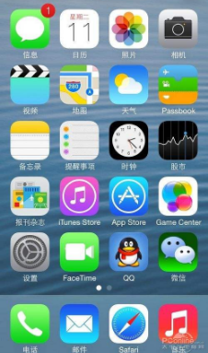
0.1.2 OS: Lifetime of program “hello” (5/9)
  关注各个进程直接如何共享数据和硬件设备
  同时保证数据的正确性和设备的有效使用
OS
管理与共享
CPU/MEM/DISK/IO
2019

Slide 15
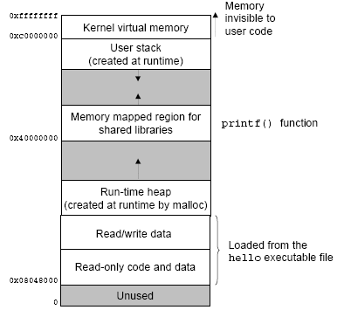
0.1.2 OS: Lifetime of program “hello” (6/9)
2019

Slide 16
0.1.2 OS: Lifetime of program “hello” (7/9)
What is inside OS?
Processes
Virtual memory
Files
Processor
Main memory
I/O devices
201001V1.1
Notes:
The operating system achieves both goals via the fundamental abstractions shown in this Figure.
The files are abstractions for I/O devices. Virtual memory is an abstraction for both the main memory and disk I/O devices. And processes are abstractions for the processor, main memory, and I/O devices. We will discuss each in turn.

Slide 17
0.1.2 OS: Lifetime of program “hello” (8/9)
Process
Virtual Memory
File
shell
process
hello
process
Time
Application code
Context
switch
OS code
Application code
OS code
Context
switch
Application code
201001V1.1
Notes:
A process is the operating system’s abstraction for a running program. With the help of process , the operating system provides the illusion that the program is the only one running on the system.
The program appears to have exclusive use of both the processor, main memory, and I/O devices. The processor appears to execute the instructions in the program,one after the other, without interruption. And the code and data of the program appear to be the only objects in the system’s memory.
In fact Multiple processes can run concurrently on the same system, and each process appears to have exclusive use of the hardware. This is what we call concurrency. instructions of different process are interleaved executed. In order to keep each processes run correctly, the system will keep the state of each process. The state is called the context. It contains current values of the PC, the register file, and the contents of main memory. When the operating system decides to transfer control from the current process to a some new process, it
performs a context switch by saving the context of the current process, restoring the context of the new process, and then passing control to the new process.
There are two concurrent processes in our example scenario: the shell process and the hello process. Initially, the shell process is running alone, waiting for input on the command line. When we ask it to run the hello program, the shell invokes a special function called system call that pass control to the operating system. The operating system saves the shell’s context, creates a new hello process and its context, and then passes control to the new hello process. This is where the context switch happens. After hello terminates,
the operating system restores the context of the shell process and passes control back to it.
The concurrency brings us convenient and at the same time makes it difficult to obtain the accurate measurement of the running time. We’ll continue this topic in chapter 9.

Slide 18
0.1.2 OS: Lifetime of program “hello” (9/9)
不同的程序→进程/线程( 描述/信息/状态/存储)→并发性(同步与互斥，饥饿和死锁)
内存管理/虚拟内存(解决进程的有效存储问题)
调度(解决进程间CPU分配问题)
I0和文件(主要是硬盘存储管理和文件管理)
2019

Slide 19
Unit 0. About this course
0.1 Introduction of this course
  0.1.1 Programmers: Lifetime of program “hello”
  0.1.2 OS: Lifetime of program “hello”
  0.1.3 SLP: Lifetime of program “hello”
  0.1.4 summary
2019
Notes:
First of all, in section 1, we will talk about the content.
In section 2 and 3, we will list the rules of the class and some reference materials.
In the last part, we will share some suggestions about how to learn this course.

Slide 20
0.1.3 SLP: Lifetime of program “hello”(1/8)
Objective(白话版)
  通过操作系统我们明白了进程管理，同步互斥，虚拟内存管理，文件管理
  但我们仍然不清楚进程化为进程映像后，程序究竟是如何执行的？
  因此当程序运行出现问题时，很难准确定位错误
2019
Notes:
These two questions outline the contents covered by this course.
<<write great code>>绪论部分
You are be able to Writing High Level，Thinking Low Level . This means that when you write your code, you are not only think about the instructions to accomplish the task, but also how they will work on the computer system.

Slide 21
0.1.3 SLP: Lifetime of program “hello” (2/8)
SLP focuses on
  汇编+C
  数据分配
  运行时堆栈变化
  内存泄露
  代码安全性
  性能优化
2019

Slide 22
0.1.3 SLP: Lifetime of program “hello” (3/8)
Objective(口号版)：
  Provides students with a programmer-level view of computer system
    1) learn computer system
    2) learn some advanced programming topics of C
  Writing High Level，Thinking Low Level (运用底层语言思想编写高级语言代码)
  为进一步理解SLP内容，回答4个问题
2019
Notes:
These two questions outline the contents covered by this course.
<<write great code>>绪论部分
You are be able to Writing High Level，Thinking Low Level . This means that when you write your code, you are not only think about the instructions to accomplish the task, but also how they will work on the computer system.

Slide 23
Q1:Any differences in behavior ? (4/8)
  A
  #define ARRAY_SIZE 10
  #include <stdio.h>
  void main()
  {
  int array[ARRAY_SIZE];
  int i =1;
  while (i <= ARRAY_SIZE)
  {
  array[i] = i - 1;
  i = i + 1;
  }
  printf("completed!\n");
  }
  B
  void main()
  {
  int i =1;
  int array[ARRAY_SIZE];
  while (i <= ARRAY_SIZE)
  {
  array[i] = i - 1;
  i = i + 1;
  }
  printf("completed!\n");
  }
2019
Notes:
A: &i : 0x0012ff54
array:0x0012ff58
Function main() will pop an access violence message.
B: &i: 0x0012ff7c
array: 0x0012ff54
Function main() can’t return, Endless loop
As you can see, here I post 2 similar code segment. The different parts have already be high lightened. You can work in groups to figure out wither these two codes have the same behavior after execution.
Ok, you can type it into your computer and run them. Also you can try to use the debug tool to analyze them. Share your opinions with your classmates and discuss. I will give you a few minutes and after that I hope some one will share their opinions with us voluntarily.
Ok, time is up. Some of you guys seem to have found out some interesting clues.
Can you tell me the results you see and why they behave differently. Come on, Any volunteers? Ok, now its my turn to invite some lucky ones.
Please tell us your conclusion. Thank you. Any one else?
Fantastic/very good.
They do behavior differently. Code A will throw an exception in run time and code B will never return since the while loop never meets its end condition.
This is because variable array and i are arranged in different order in the stack.
Both code A and B has array access violation. But in code B the i will be rewrite to 4 again and again and cause endless loop. The condition in A is totally different because the instruction will access the boundary fence and trigger an exception.
For further details, please see the episode.

Slide 24
Q2: Any problem in security? (5/8)
int getbuf()
{
char buf[16];
getxs(buf);////change hexadecimal number, in ascII code, into digit number in decimal
return 1;
}
2019

Slide 25
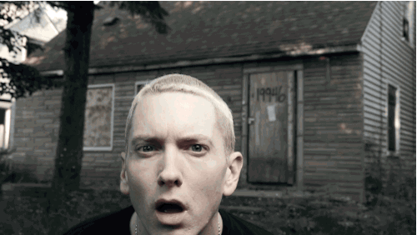
Q3: Why function call triggers run time error ? (6/8)
tcpclient.c : by one of our students
I’m trying really hard to find the dammed bugs.
2019

Slide 26
Q4: Any differences in Performance ? (7/8)
  A
  for(i=0;i<n;i++)
  for(j=0;j<n;j++)
  {
    sum=0.0;
    for(k=0;k<n;k++)
    sum += A[i][k]*B[k][j];
    C[i][j] = sum;
  }
  B
  for(k=0;k<n;k++)
  for(i=0;i<n;i++)
  {
    r=A[i][k];
    for(j=0;j<n;j++)
    C[i][j] += r*B[k][j];
  }
2019
Notes:
*xp+=*yp;*xp+=*yp; not *xp += 2**yp;
This is question 2. we also post two segments of code. Then function of code is to calculate the Product of matrices A and B and stored the result in matrix C. And The different parts have already be high lightened. These two codes both contain nested loop. Work in groups to figure out is there any performance difference between these two codes and why.
I will give you a few minutes and after that I hope some one will share their opinions with us voluntarily.
Ok, time is up. Some of you guys seem to have found out some interesting clues. Can you tell me the results your group have reached. Come on, Any volunteers? Ok, now its my turn to invite some lucky ones.
Please tell us your conclusion. Thank you. Any one else?
Fantastic/very good/its very close to the right answer.
First, we can see both A and B access the memory the same times. Code A accesses elements of array c for n*n (n squared) times; accesses elements of array A and B for n*n*n (cubed) times. Code B accesses elements of array a for n*n (n squared) times; accesses elements of array c and B for n*n*n times.
When n is small, all three arrays A,B and C may be load to cache. And A B show the similar performance.
But with the increase of constant n, code B is better than A.
According to the way the cache works, code B may cause a much lower cache miss rate in execution while code A may lead to a higher cache miss rate.
We will discuss more further in the future study.

Slide 27

投票
最多可选1项
Which one is faster, A or B?
A
A
B
B
提交
2019

Slide 28
Unit 0. About this course
0.1 Introduction of this course
  0.1.1 Programmers: Lifetime of program “hello”
  0.1.2 OS: Lifetime of program “hello”
  0.1.3 SLP: Lifetime of program “hello”
  0.1.4 summary
2019
Notes:
First of all, in section 1, we will talk about the content.
In section 2 and 3, we will list the rules of the class and some reference materials.
In the last part, we will share some suggestions about how to learn this course.

Slide 29
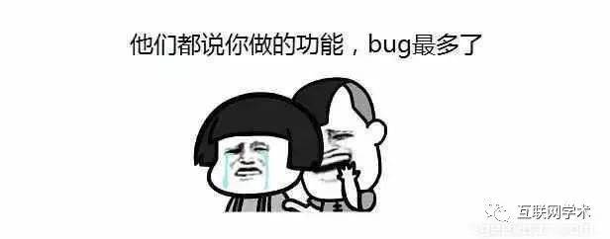

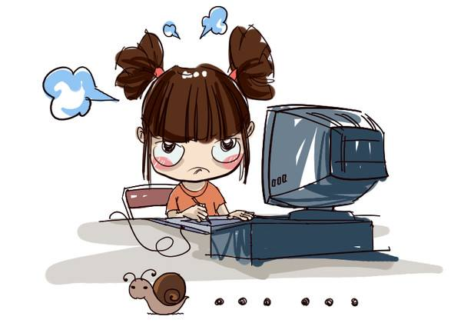
0.1.4 summary (1/3)
哎呦!又在加班写bug啊
不要给黑客留下攻击的漏洞
2019
慢
Notes:
史上破坏力最大的10种计算机病毒排名

Slide 30
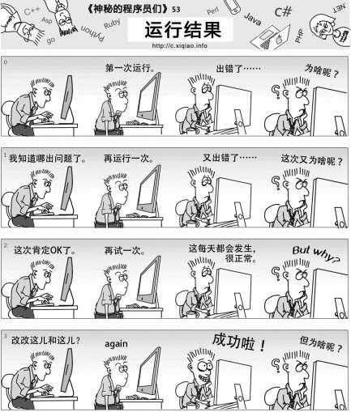
0.1.4 summary (2/3)
那些年我们调过的Bug (10/9)
2019

Slide 31
0.1.4 summary (3/3)
After you learn this course, you will
  be on your way to becoming a rare “power programmer,” enlightened by an understanding of the underlying computer system and its impact on your application programs [from CSAPP]
  Hold Positions as Senior [from SSD6]
    Those who can be considered as a member of the “rare breed of programmers”
    Those who can consistently produce quality software that is faster and more reliable.
2019
Notes:
You are no longer an ordinary programmer. You arm yourself not only the programming skill but also a deep understanding of the relationship between computer system and the program itself.
Software test engineer, It tells how and why programmers make mistakes and make you easier to locate other programmer’s bug.

Slide 32
Unit 0. About this course
0.1 Introduction of this course
0.2 More details on SLP
0.3 Reference on SLP
0.4 Some suggestions
2019
Notes:
First of all, in section 1, we will talk about the content.
In section 2 and 3, we will list the rules of the class and some reference materials.
In the last part, we will share some suggestions about how to learn this course.

Slide 33
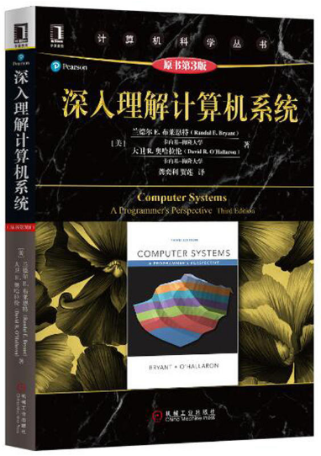

0.2 More details on SLP(1/3)
Text Book
  A book: CSAPP
  A file : ssd6.chm
Tools & Environment:
SLP: Windows +
VS 2017/Code Blocks
2019
Notes:
We use two text books, the major one is the book <Computer Systems A programmer’s perspective>, the second one is an electronic file named SSD6.CHM. You can download it from our website. SSD6.CHM is much simple and practice than the textbook. We will tell you which chapter and section you should read in the lecture. So don’t worry about how thick the book is . Take it easy.

Slide 34
0.2 More details on SLP (2/3)
Each weeks :2*( lecture(2 periods) + practice(1 periods))
Practice/上机：
  Labs
Multiple Choice Questions
  Lab practice.
2019
Notes:
Each week you will take 2 class hour lecture plus one class hour practice.
During the lab time, you are required to finish both Multiple Choice Questions and one Lab practice. Due to the limited time, you may unable to finish all the task in the classroom.
But you should submit your homework before the deadline.

Slide 35
Schedule:
weeks | Lectures | Labs | chapters
1.1 1.2 | introduction Representation of Data | How debug a c/c++ program Bit manipulation (optional) | 1 2~3
2.1 2.2 | Representation of Code Representation of Structured Data | Key1&key2 | 2~3
3.1 3.2 | Function Call and Return：stack frame栈帧 Project evaluation | Key3&key4 (optional) Buffer bomb | 2~3
4.1 4.2 | Memory Layout and Allocation Memory related bugs | mymalloc Memory related bugs | 3/10
5.1 5.2 | Garbage collection Performance Measurement | Project evaluation (mymalloc) Performance Measurement | 5/9
6.1 6.2 | Optimizing Program Performance Cache and Cache-Aware Programming | Program Performance Optimization | 6
7.1 7.2 | Linking and Linker Practice | Mini Linker(optional) | 7
2019

Slide 36
Unit 0. About this course
0.1 Introduction of this course
0.2 More details on this course
0.3 Reference on SLP
0.4 Some suggestions
2019
Notes:
这部分可以少说，快点放一遍。
Now, besides the textbook , I will introduce some reference books to you. Some of it is very useful in finish our lab practice.

Slide 37

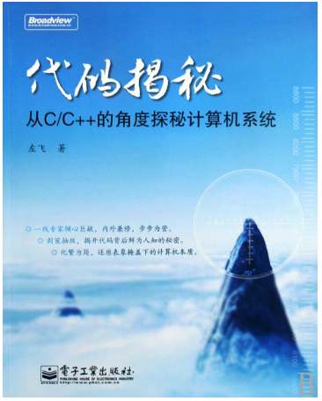


0.3 Reference on SLP (1/4)
Similar books
Write Great Code volume 1 & 2
2019
Notes:
These two books are similar to our textbook, you can use as a supplement .

Slide 38


0.3 Reference on SLP (3/4)
Linker and Loader books
2019
Notes:
You can read these books in the later part of this course. They give you a deep insight into how the linker and loaders is working. How the static and dynamic library is linked.

Slide 39
0.3 Reference on SLP (4/4)
http://csapp.cs.cmu.edu/
2019
Notes:
You can also get reference from this website.

Slide 40
Unit 0. About this course
0.1 Introduction of this course
0.2 More details on this course
0.3 Reference on SLP
0.4 Some suggestions
2019
Notes:
Ok, lets move to the suggestions.

Slide 41
0.4 Some suggestions(1/1)
1．Learning by doing：
2．Extend Reading： Not Everything will be covered on class
3． Having the courage to ask questions and discuss with your classmates
Failure reasons from VIP
  A late start
  Not focused
  Not familiar with C program
2019
Notes:
This course is known as one of the most difficult ones. But don’t be afraid and don’t give up easily. Know a little is better than know nothing. Although every step is a challenge and it is at the same time one more step towards success.

Slide 42
单选题
1分
Consider the following fragment of C++ source code.
String msg; unsigned int x; int y;
cin >> msg >> x >> y;
cout << x + y;
Which of the following is (are) true regarding execution of the segment?
A
The input statement will always take the same amount of time to execute.
B
The output statement will always be executed immediately after the input statement.
C
If x and y are both positive, an integer greater than both will be printed.
D
None
提交
201001V1.1

